Slide 1

DATA STRUCTURES AND ALGORITHMS (113215)
Dr. Owais Hussain

Slide 2

Agenda
Merge Sort
Quick Sort
Dynamic Arrays
Where to go from here?

Slide 3
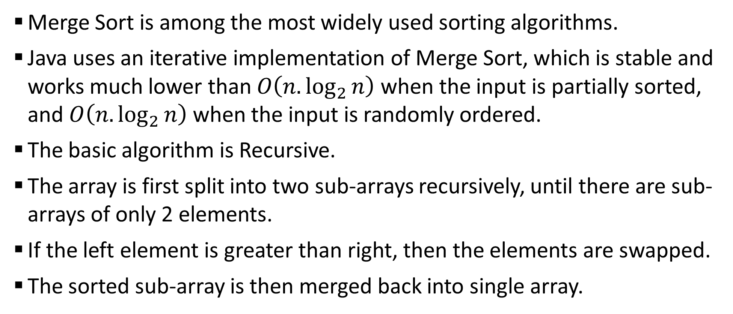
Sample 2
Merge Sort
Merge Sort is among the most widely used sorting algorithms.
Java uses an iterative implementation of Merge Sort, which is stable and works much lower than $O\left(n.\log_{2}{n}\right)$ when the input is partially sorted, and $O\left(n.\log_{2}{n}\right)$ when the input is randomly ordered.
The basic algorithm is Recursive.
The array is first split into two sub-arrays recursively, until there are sub-arrays of only 2 elements.
If the left element is greater than right, then the elements are swapped.
The sorted sub-array is then merged back into single array.

Slide 4
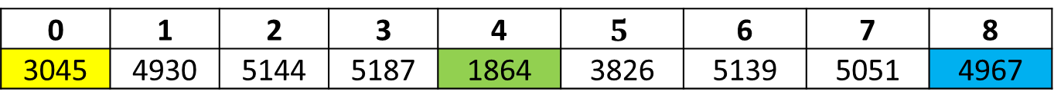
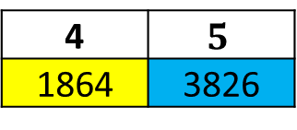
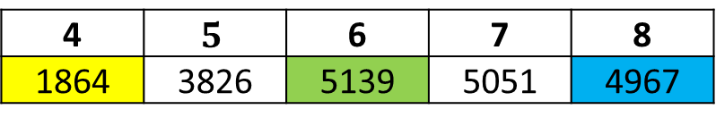
Sample 2
Merge Sort
0 | 1 | 2 | 3 | 4 | $$5$$ | 6 | 7 | 8
3045 | 4930 | 5144 | 5187 | 1864 | 3826 | 5139 | 5051 | 4967
0 | 1 | 2 | 3
3045 | 4930 | 5144 | 5187
4 | $$5$$ | 6 | 7 | 8
1864 | 3826 | 5139 | 5051 | 4967
0 | 1
3045 | 4930
2 | 3
5144 | 5187
4 | $$5$$
1864 | 3826
6 | 7 | 8
5139 | 5051 | 4967
0
3045
1
4930
2
5144
3
5187
4
1864
5
3826
6
5139
7 | 8
5051 | 4967
The splitting is like Binary search. Yellow represents lower bound; Green is the mid position and Blue represents higher bound.
7
5051
8
4967

Slide 5
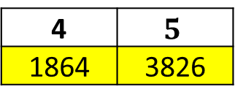
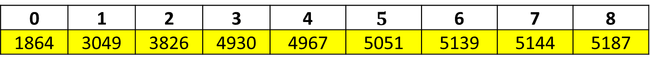
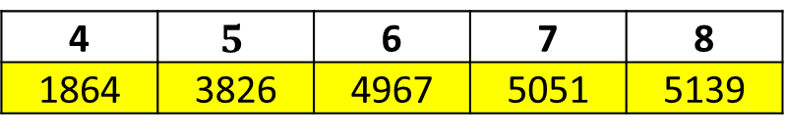
Sample 2
Merge Sort
7
5051
8
4967
0
3045
1
4930
2
5144
3
5187
4
1864
5
3826
6
5139
7 | 8
4967 | 5051
0 | 1
3045 | 4930
2 | 3
5144 | 5187
4 | $$5$$
1864 | 3826
6 | 7 | 8
4967 | 5051 | 5139
0 | 1 | 2 | 3
3049 | 4930 | 5144 | 5187
4 | $$5$$ | 6 | 7 | 8
1864 | 3826 | 4967 | 5051 | 5139
0 | 1 | 2 | 3 | 4 | $$5$$ | 6 | 7 | 8
1864 | 3049 | 3826 | 4930 | 4967 | 5051 | 5139 | 5144 | 5187
Note that the sub-arrays are merged in sorted order. But since each sub-array is sorted itself, therefore there’s no need for nested arrays in implementation.

Slide 6
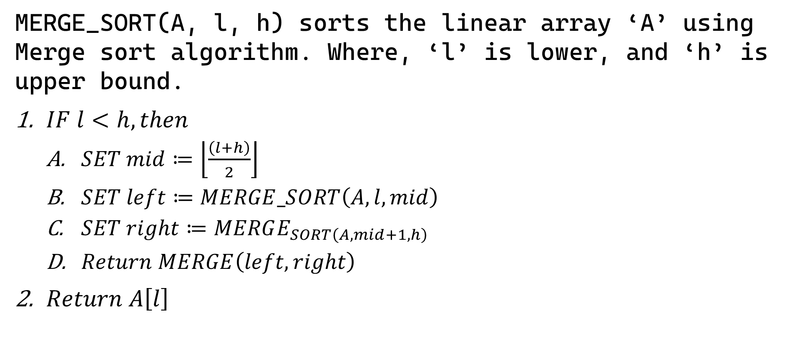
Sample 2
Merge Sort
MERGE_SORT(A, l, h) sorts the linear array ‘A’ using Merge sort algorithm. Where, ‘l’ is lower, and ‘h’ is upper bound.
$IF l<h, then$
$SET mid≔\left\lfloor \frac{\left(l+h\right)}{2}\right\rfloor$
$SET left≔MERGE_SORT\left(A, l,mid\right)$
$SET right≔MERGE_{SORT\left(A,mid+1,h\right)}$
$Return MERGE\left(left, right\right)$
$Return A\left[l\right]$

Slide 7
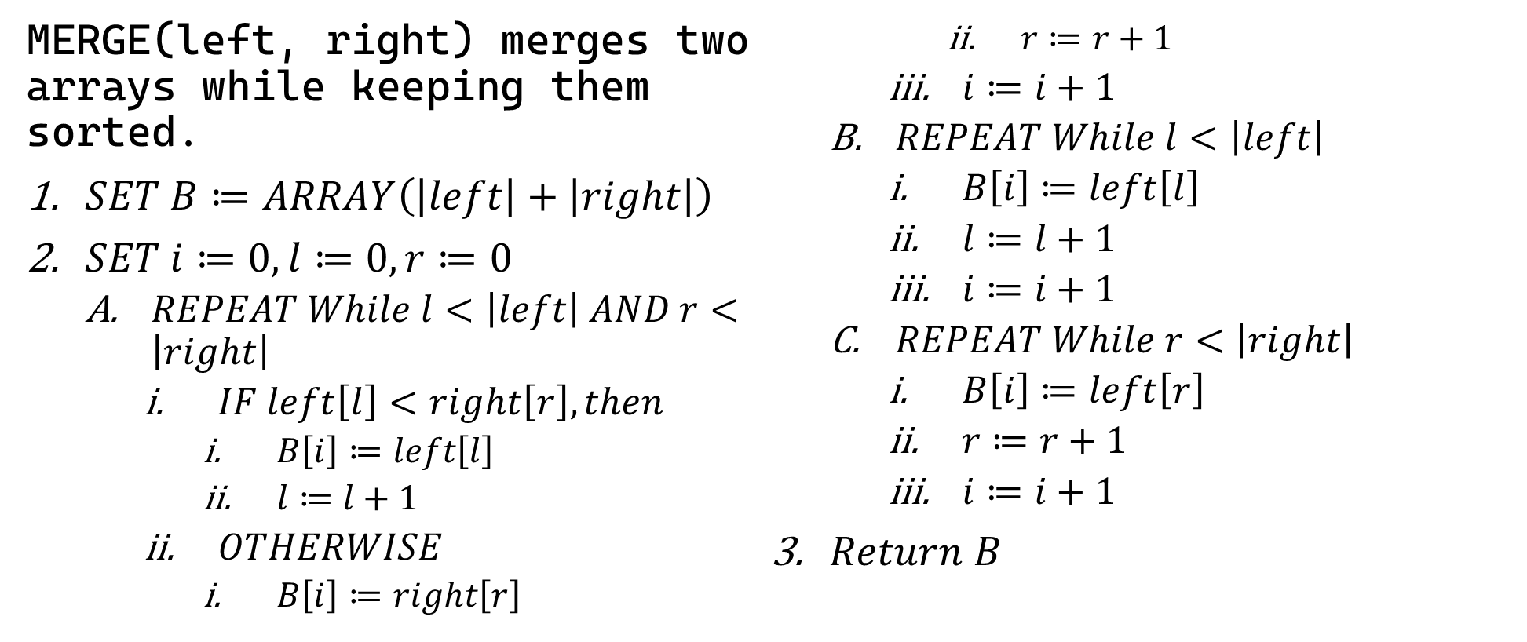
Sample 2
Merge Sort
MERGE(left, right) merges two arrays while keeping them sorted.
$SET B≔ARRAY\left(\left|left\right|+\left|right\right|\right)$
$SET i≔0, l≔0, r≔0$
$REPEAT While l<\left|left\right| AND r<\left|right\right|$
$IF left\left[l\right]<right\left[r\right], then$
$B\left[i\right]≔left\left[l\right]$
$l≔l+1$
$OTHERWISE$
$B\left[i\right]≔right\left[r\right]$
$r≔r+1$
$i≔i+1$
$REPEAT While l<\left|left\right|$
$B\left[i\right]≔left\left[l\right]$
$l≔l+1$
$i≔i+1$
$REPEAT While r<\left|right\right|$
$B\left[i\right]≔left\left[r\right]$
$r≔r+1$
$i≔i+1$
$Return B$

Slide 8
Sample 2
Quick Sort
A fun way to understand how Quick Sort works can be found on YouTube by AlgoRythmics: Quick-sort with Hungarian folk dance(Küküllőmenti legényes)
Notes:
Küküllőmenti legényes is pronounced as “koo-koo-lu-menti la-gini-yesh”

Slide 9
Sample 2
Dynamic Arrays
Did you know that: …
THERE IS NO SUCH THING AS A STATIC ARRAY IN PYTHON?
Yes. Python uses Dynamic Arrays which grow over time.
Initial size of array depends on the number of items during initialization.
When an element is inserted into an array, the array first goes through EXPAND operation and gets double in size.
The size keeps doubling as more and more items are appended.
This is an example of a Dynamic Array. In Java, the same objective is achieved by using ArrayList.
Similarly, C# offers Generic Lists to be used as Dynamic Arrays.

Slide 10
Sample 2
Where to go from here?
This course equipped you with all the weapons you need to start on your journey to become a good problem solver in the universe of data.
You should first visit the main topic of Graphs and see how Dijkstra’s algorithm solves a rather important problem.
Then there are various topics in trees like AVL trees and Splay trees to enhance your understanding and application on Tree data structures.
Next are topics like Minimum spanning tree and Rabin Karp’s algorithm for pattern matching.
The Blockchain world is founded on the fundamentals taught in this course. You should explore the possibilities there.
Being at the top of all Core subjects in Computer Science, excellence in this course guarantees future success in all branches of Computing. So, keep sharpening your Axe and never settle.

Slide 11



THANK YOU
Owais Hussain
+92 345-3174270
owais.hussain@kiet.edu.pk
https://www.researchgate.net/profile/Owais-Hussain-3

